Slide 1
us_covid19_daily
D. KHLOUD AL JALLAD
S. SABRIN ALHRIRI

Slide 2
index
Dataset description
feature (column).
STEPS WORK

Slide 3
Dataset description
Context
Data is obtained from COVID-19 Tracking project and NYTimes. Sincere thanks to them for making it available to the public.
Coronaviruses are a large family of viruses which may cause illness in animals or humans. In humans, several coronaviruses are known to cause respiratory infections ranging from the common cold to more severe diseases such as Middle East Respiratory Syndrome (MERS) and Severe Acute Respiratory Syndrome (SARS). The most recently discovered coronavirus causes coronavirus disease COVID-19 - World Health Organization
The number of new cases are increasing day by day around the world. This dataset has information from 50 US states and the District of Columbia at daily level.
Notes:
Content
us_states_covid19_daily.csv
This dataset has number of tests conducted in each state at daily level. Column descriptions are
date - date of observation
state - US state 2 digit code
positive - number of tests with positive results
negative - number of tests with negative results
pending - number of test with pending results
death - number of deaths
total - total number of tests

Slide 4
us_states_covid19_daily.csv
Main Content : us_states_covid19_daily.csv
This dataset has number of tests conducted in each state at daily level. Column
descriptions are
date - date of observation
state - US state 2 digit code
positive - number of tests with positive results
negative - number of tests with negative results
pending - number of test with pending results
death - number of deaths
total - total number of tests

Slide 5
feature (column).
Y-recovered
date
states
positive
Hospitalized Currently
negative

Slide 6
feature (column).
Y-recovered
death
Date
Checked
Last
Modified
Negative
Increase
total
Death
Increase

Slide 7
STEPS WORK
Libraries.
Show Data.
Clean DATA 'missing value‘ .
PROCESSING “CONVERT TO NUMBER ONLY ”.
PLOT DATA .
Split data & work on

Slide 8
Split data & work on
1 – spilt data to train and test (80%- 20%).
2-work on data : all Algorithms :
SVM.
CLUSTERING.
Metrics with(D_tree, SVM , )
Decision Tree.
Kneighbors Classifier
Random Forest Classifier

Slide 9
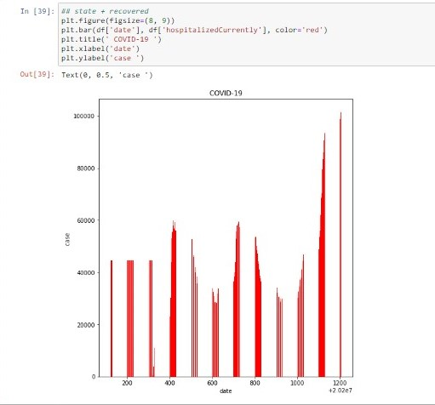
PLOT Data :D

Slide 10
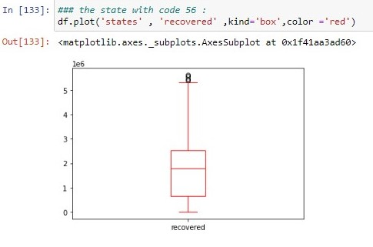

Slide 11
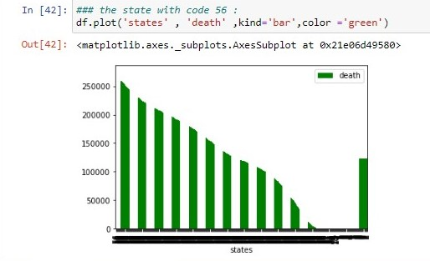

Slide 12
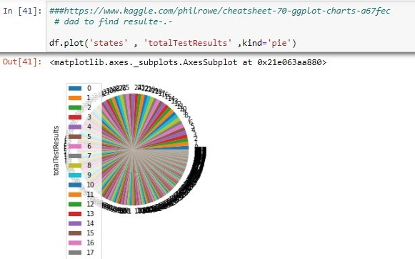

Slide 13
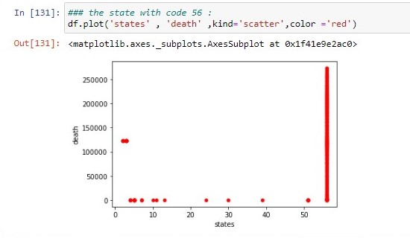

Slide 14
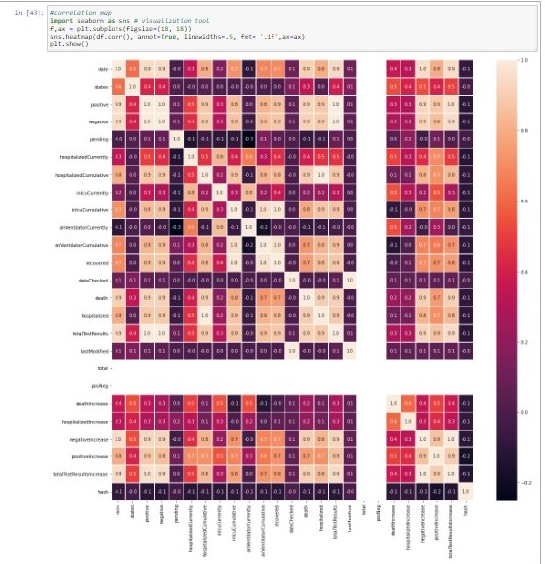

Slide 15
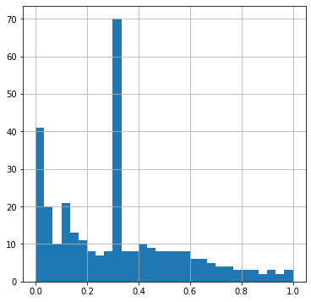
Split data & work on : “reg” SPLIT TO 5 CLASSES”classfition”

Slide 16
RBF-kernel svc
1-The first “result ”: under fitting
Accuracy of RBF-kernel SVC on training set: 0.38 Accuracy of RBF-kernel SVC on test set: 0.33
Out[45]:
SVC(C=0.001, gamma=1)
2-The second “over fitting ”:
Accuracy of RBF-kernel SVC on training set: 1.00 Accuracy of RBF-kernel SVC on test set: 0.39
Out[43]:
SVC(C=1, gamma=0.5)
Notes:
كل ما كانت عنا المعامل اكبر قيمتو = يكون التعميم اقل ازا الغلط اكبر
عنا مشكله الاوفر تنك

Slide 17
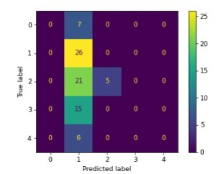
Metrics : the data un balance class 2 take the large amount from data

Slide 18
accuracy_score, precision_score, recall_score, f1_score bad training
f1_score
precision–recall score
2-Micro-averaged precision = 0.39 (treat instances equally) Macro-averaged precision = 0.27 (treat classes equally)
3-Micro-averaged recall = 0.39 (treat instances equally) Macro-averaged recall = 0.24 (treat classes equally)
1-
Micro-averaged f1 = 0.39 (treat instances equally)
Macro-averaged f1 = 0.17 (treat classes equally)

Slide 19
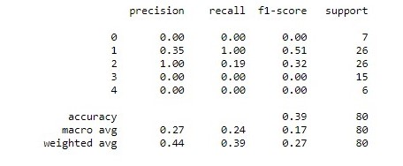

Slide 20
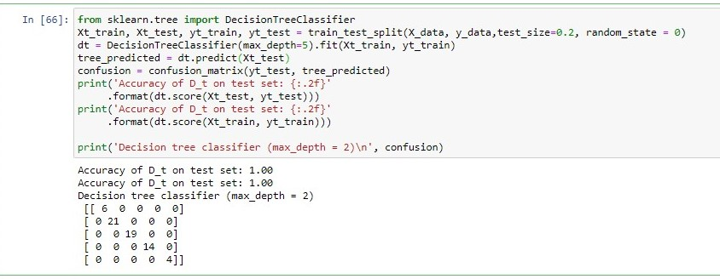
tree& confusion_matrix : 1-the first : max_depth = 5 , “result”: over fitting

Slide 21
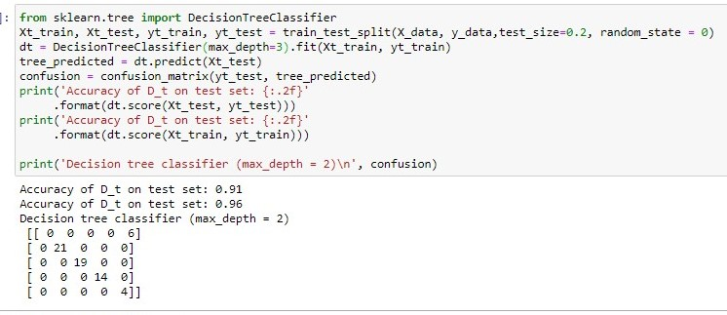
D_tree& confusion_matrix : 2-the second: max_depth = 2 , “result”: good training

Slide 22
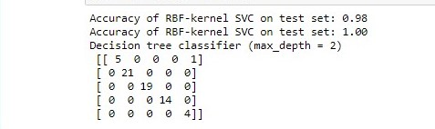
svc & D_tree & confusion_matrix good training

Slide 23
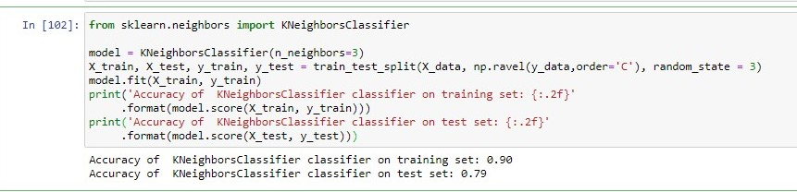
Kneighbors Classifier Goog training

Slide 24
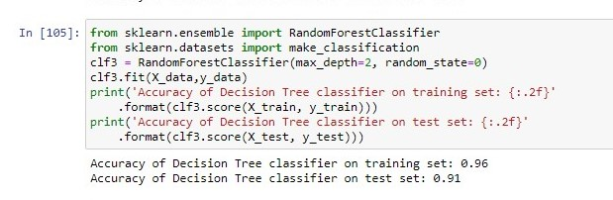
Random Forest Classifier Very Good training :D

Slide 25
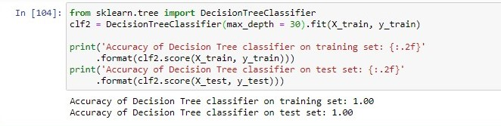
Decision Tree Classifier

Slide 26
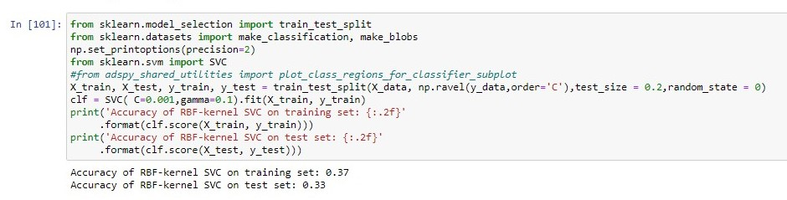
RBF-kernel SVC

Slide 27
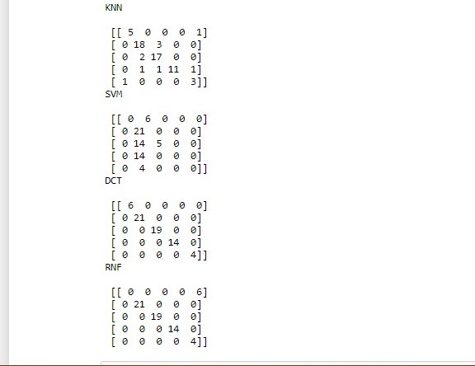
The best “ DCT & RNF“

Slide 28
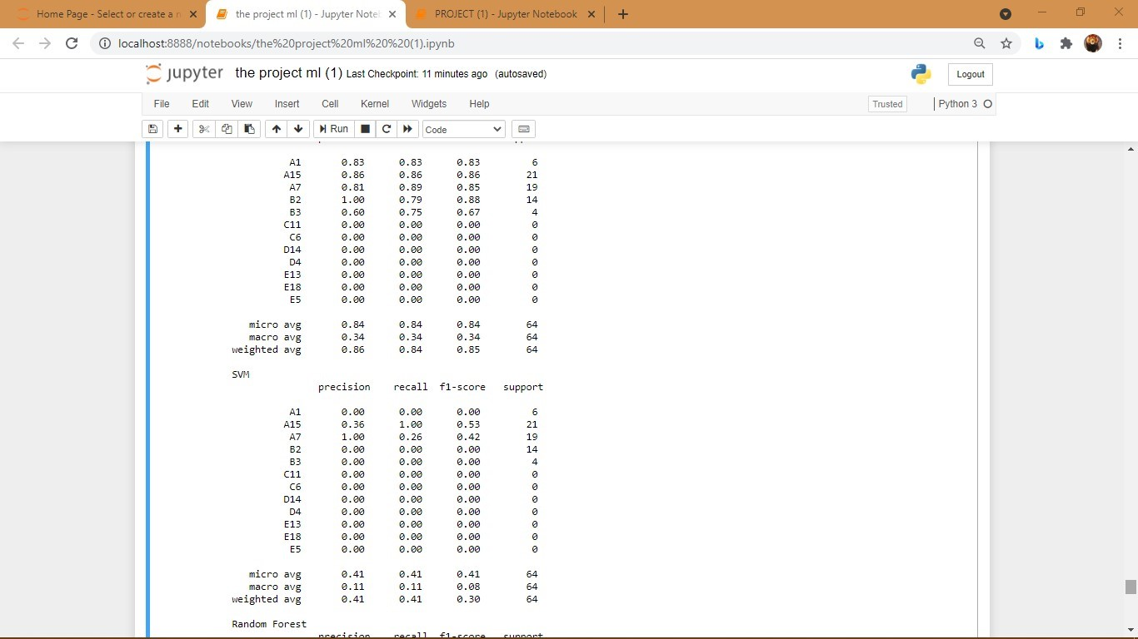
Svm &knn baaaaaaad

Slide 29
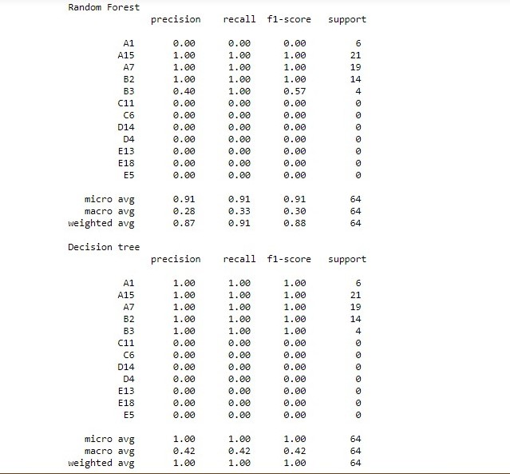
DCT & RNF

Slide 30
RNF & DCT:BAD “unbalance Data” THE RNF BETTER THAN DCT
ON RNF
Macro : IN THE NUM_CLASSES
THE RESULT : THE DATA TRAINING ONLY IN
CLASS “2 ”.
On DCT
Macro : IN THE NUM_CLASSES
THE RESULT : THE DATA TRAINING ONLY IN
CLASS “2
micro avg 0.91 0.91 0.91 64 macro avg 0.28 0.33 0.30 64 weighted avg 0.87 0.91 0.88 64
micro avg 1.00 1.00 1.00 64
macro avg 0.42 0.42 0.42 64
weighted avg 1.00 1.00 1.00 64
Notes:
هلا اجمالا الاداء سيء لانو الداتا مانها بلنس
ولكن نوعا ما منطقيه على الغابه العشوائيه لانو ولكن على الشجره نو لانو عم تبصم اكتر من هداك يعني عميه على الاخر
هداك شايف بصيص نور
+++++++
ولكن الاداء اجمالا سيء
منلاحظ القيمه الوسطي في كلاهما

Slide 31
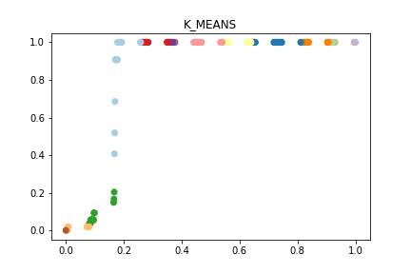
Clustering K_mean : MinMaxScaler & fit

Slide 32
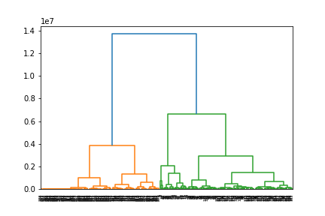
Clustering Agglomerative : fit_predict &

Slide 33
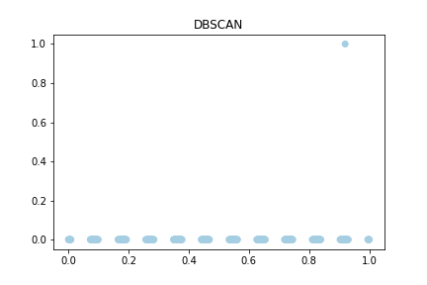
from sklearn.cluster import DBSCAN

Slide 34
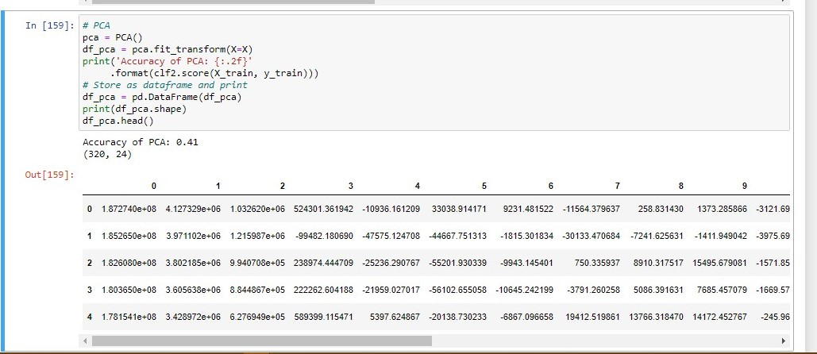
Principal Component Analysis (PCA) from sklearn.decomposition import PCA

Slide 35
Thanks

